Slide 2
Deep Learning Dynamos
Gema Csanád

Slide 3
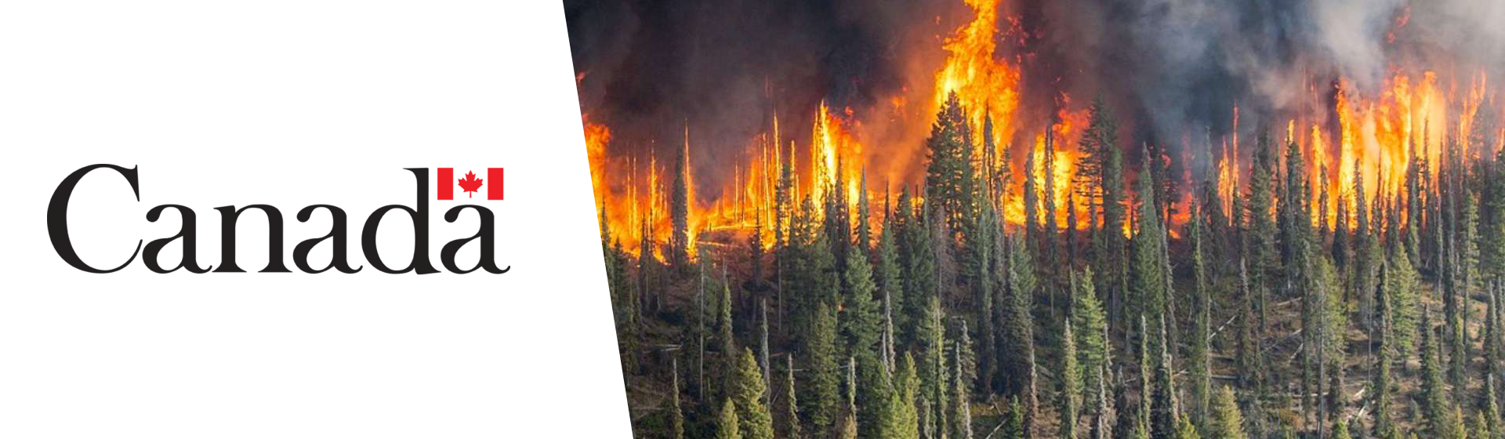
Topic: Wildfire Detection Using Satellite Images

Slide 4
Autonomous Satellite Wildfire Detection Using Hyperspectral Imagery and Neural Networks:
Hyperspectral Imagery
1D-CNN
Real-time analysis
Deployed in Australia
Source

Slide 5
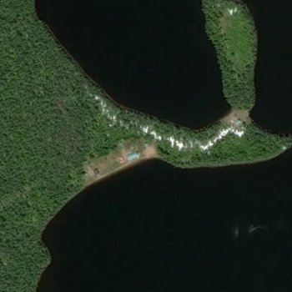
Data exploration
Kaggle
Wildfire : 22710 images
No wildfire : 20140 images
70/15/15

Slide 6
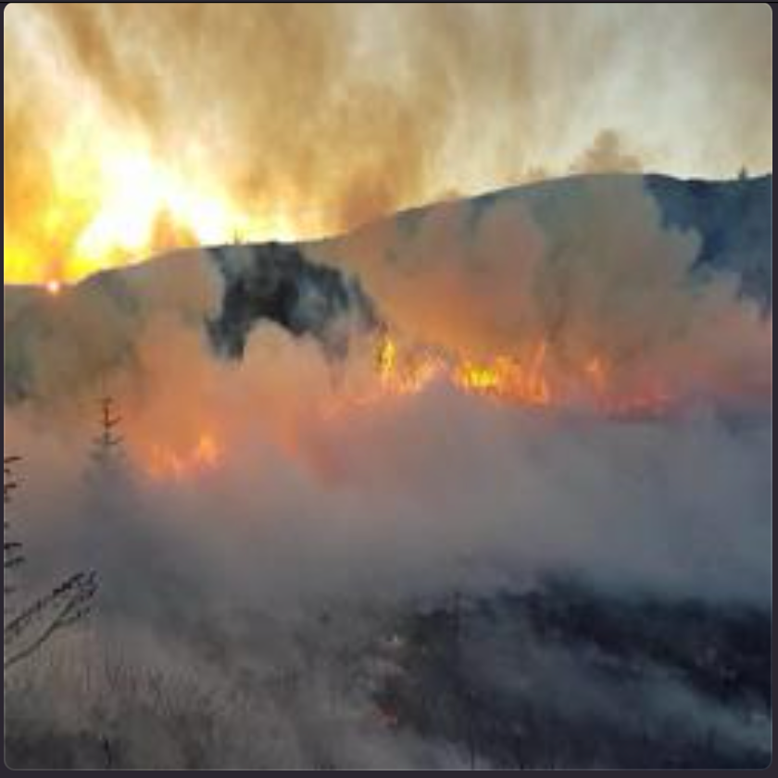
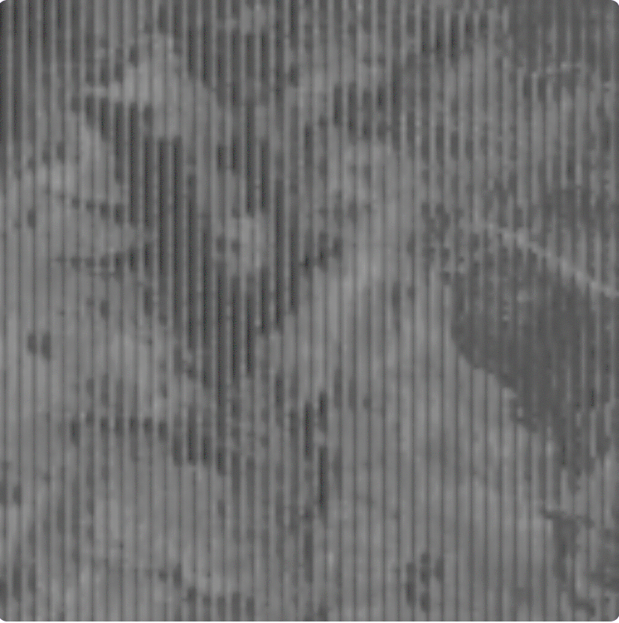
Other Datasets

Slide 7
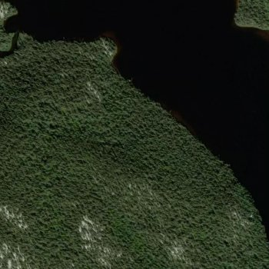
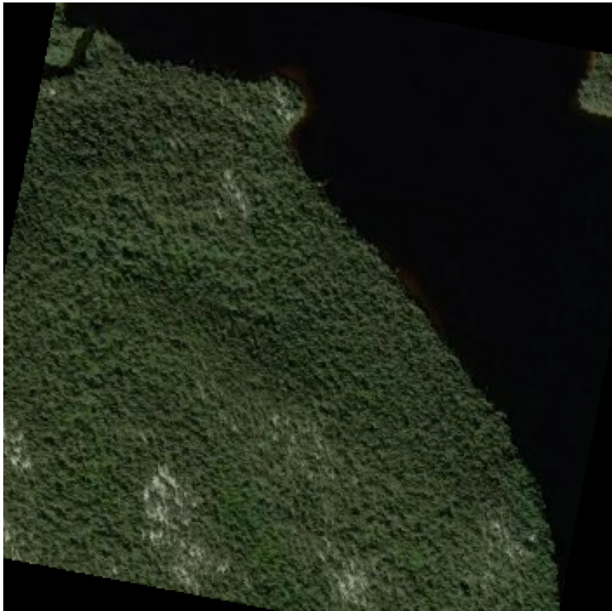
Data augmentation
Original
Rotation (±30°)

Slide 8
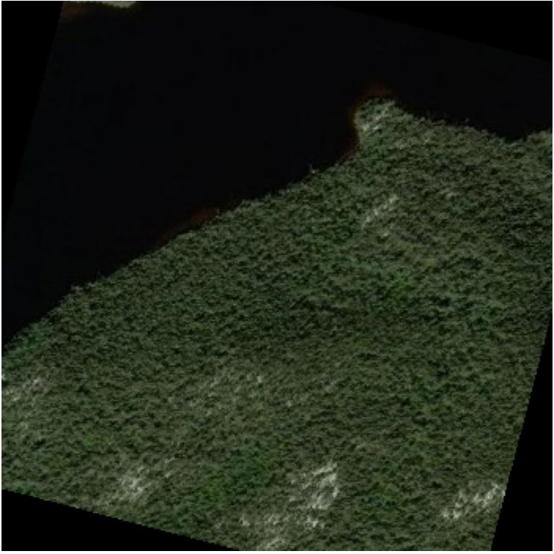
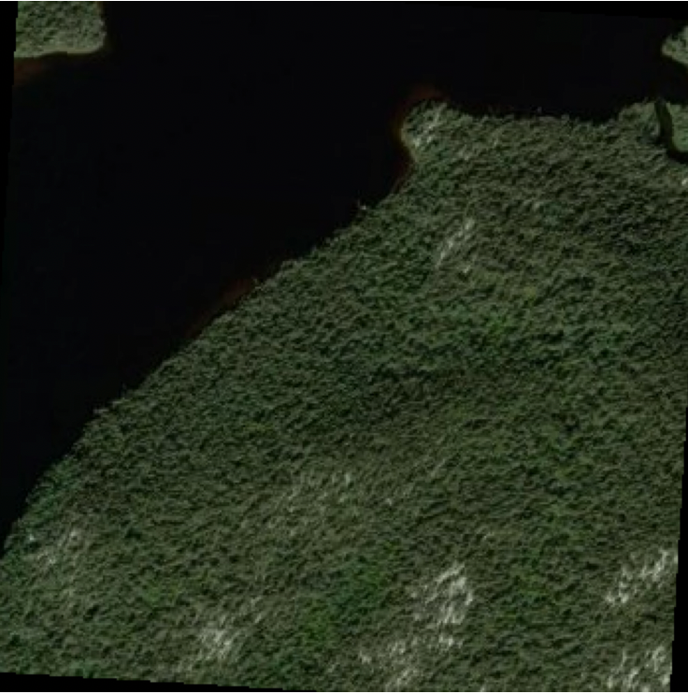
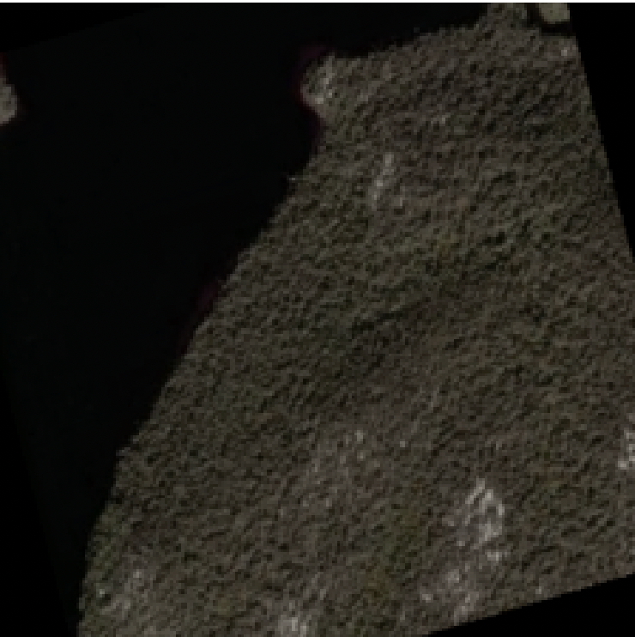
Data augmentation
Random Horizontal
Flipping
Random Resized
Crop
Colour Adjustments

Slide 9
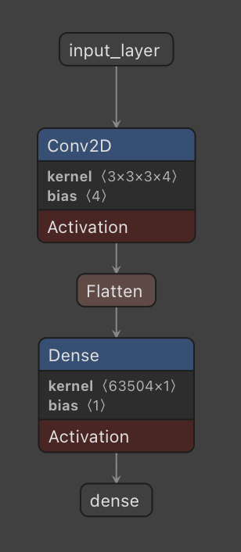
Baseline model: 2D CNN
Spatial Feature Extraction
Translation Invariance
Hierarchical Feature Learning
Performance
Discriminative Features for Smoke vs. Clouds

Slide 10
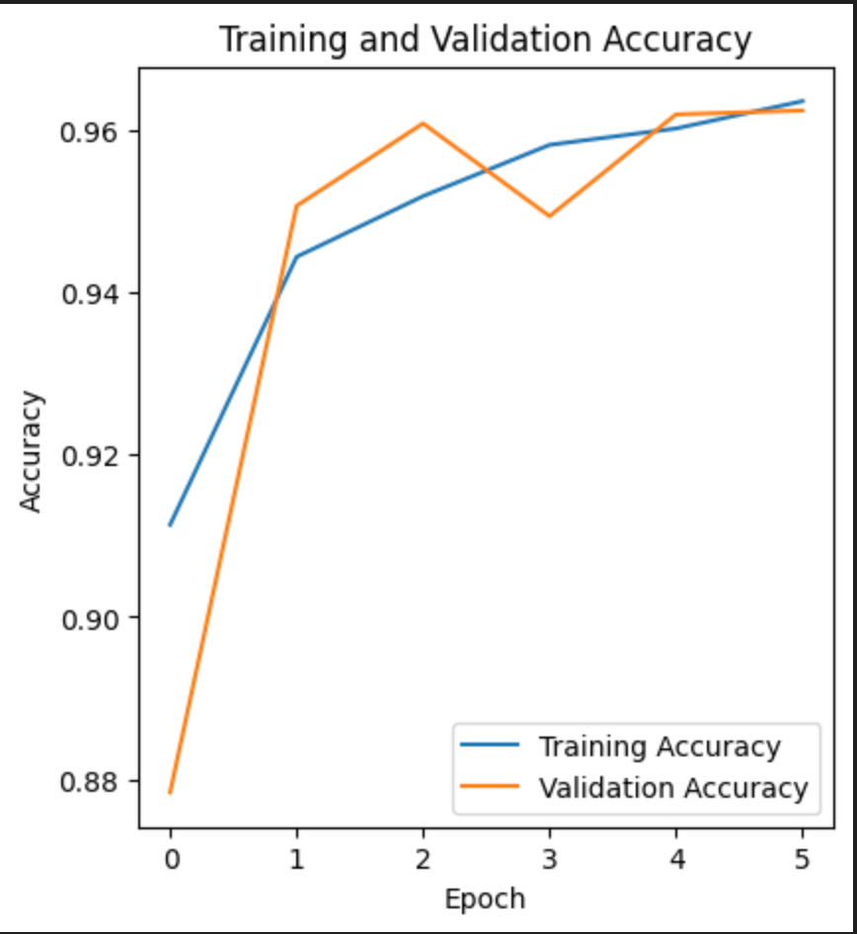
Training
Binary cross-entropy loss
Optimizer: Adam
Initial learning rate: 0.001
Batch size: 32
Early stopping

Slide 11
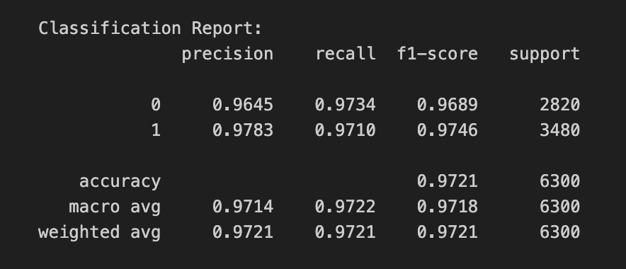
Validation set
Accuracy
Precision
Recall
F1

Slide 12
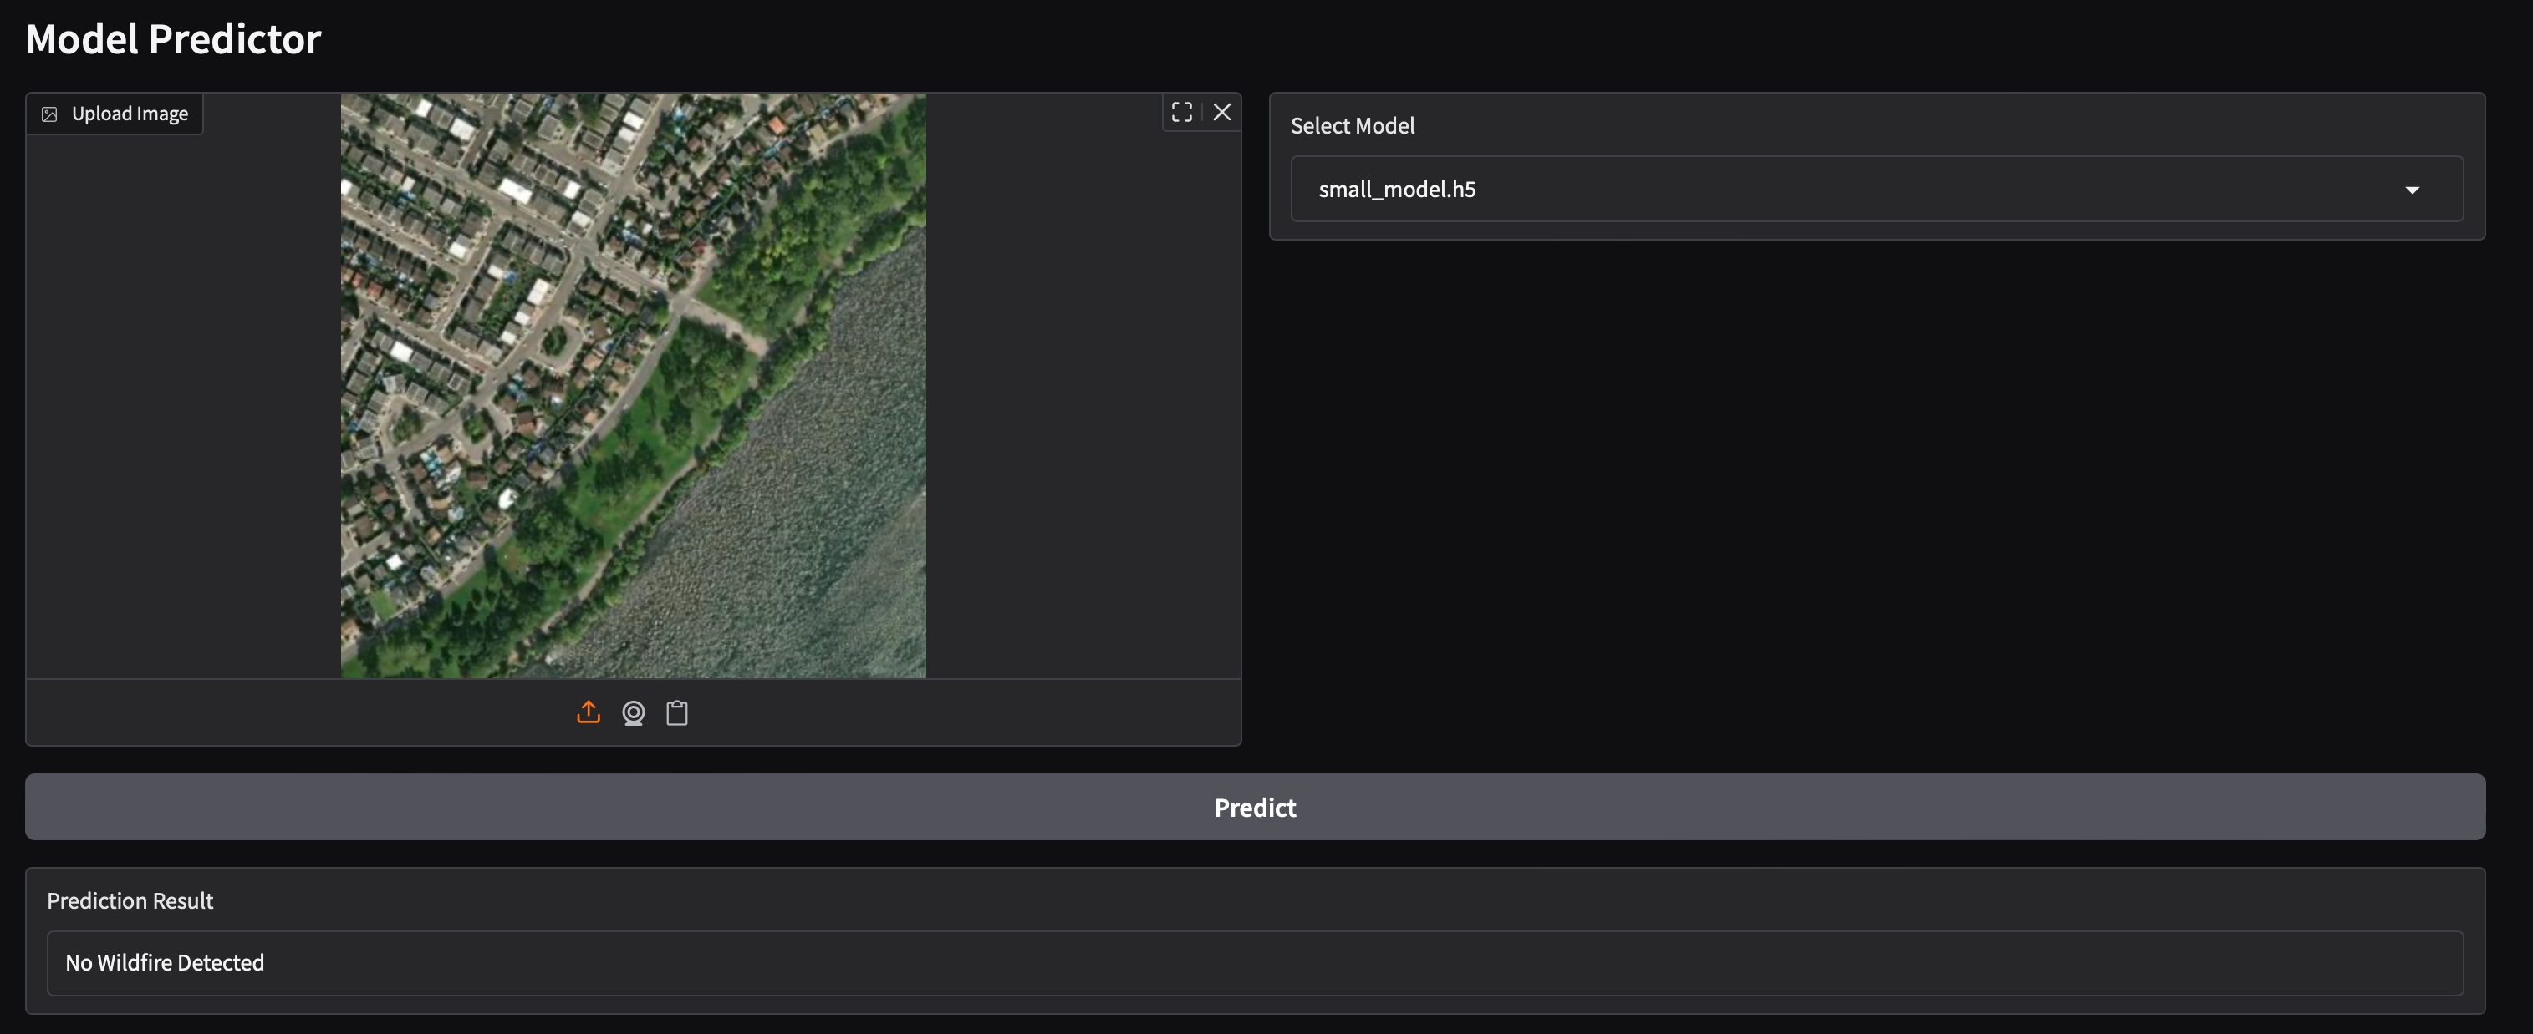
GUI
Gradio
Web based
Upload photo
Can choose from models
Detects wildfire

